Slide 1


Language Learning App for Vocabulary and Lesson Management
We have explored the design and implementation of an interactive language learning app that leverages data structures and algorithms to enhance vocabulary acquisition and lesson management.
Notes:
1

Slide 2
Key Features
Vocabulary Management
Lesson Tree
Learning Path
Quiz System
Build a hierarchical structure of lessons for a structured learning experience.
Generate an optimized sequence of lessons using tree traversal for efficient learning.
Interactive quizzes for vocabulary testing with performance tracking and feedback.
Add, remove, and view word translations, enhancing vocabulary acquisition.
Notes:
2

Slide 3
Core Data Structures
Stack
Queue
Priority Queue
Tracks completed lessons, supporting user progress monitoring.
Manages pending lessons, prioritizing and optimizing the learning path.
Handles prioritized lessons, ensuring high-priority lessons are addressed first.
Map
Tree
Stores vocabulary, efficiently associating words with their translations.
Represents hierarchical lessons, allowing for a structured and logical learning flow.
Notes:
3

Slide 4
Essential Algorithms
Depth-First Search (DFS)
2
Greedy Scoring
1
Assigns scores based on user quiz performance, dynamically adjusting the learning experience.
Traverses the lesson tree, generating optimal learning paths for users.
Priority-Based Sorting
4
Tree Traversal
3
Displays and organizes lessons in a hierarchical structure, making the learning process clear and intuitive.
Manages prioritized lessons using a min-heap, ensuring the most important lessons are tackled first.
Notes:
4

Slide 5
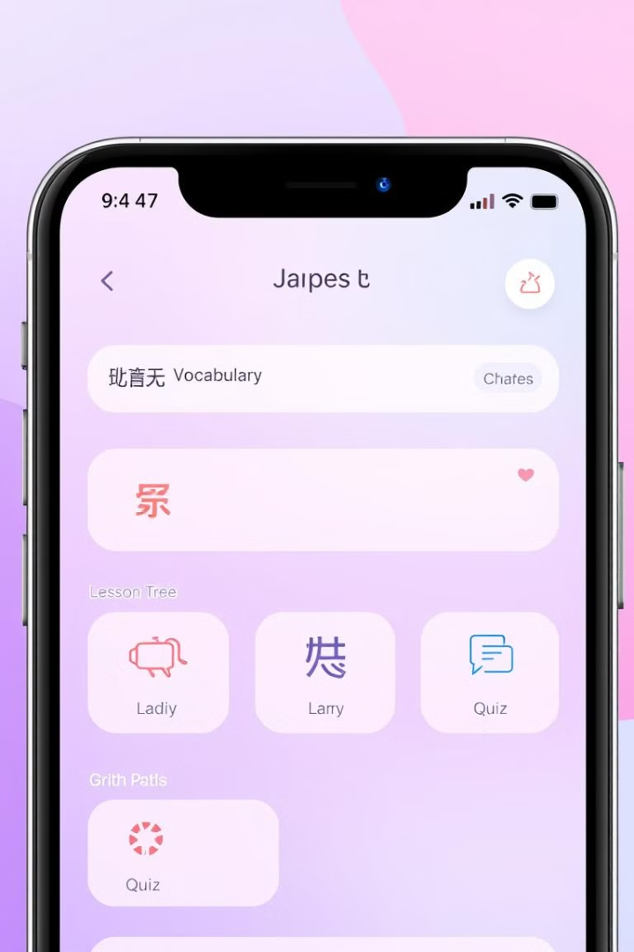




App Functionality
Vocabulary Module
Lesson Tree Module
Users add, view, and manage vocabulary words and their translations.
Lessons are structured hierarchically within a tree structure, enabling a logical learning flow.
Learning Path Module
Quiz Module
DFS algorithm generates an optimized learning path, avoiding revisiting lessons and ensuring efficiency.
Interactive quizzes based on the learning path test users' vocabulary understanding.
Notes:
5

Slide 6
User Interface Design
Interactive Menu
Real-time Feedback
Provides easy access to all functionalities, including vocabulary management, lesson tree, learning path generation, and quizzes.
Tracks user scores, progress, and provides instant feedback for a personalized learning experience.
Notes:
6

Slide 7
Benefits and Advantages
1
Educational
Enhances vocabulary knowledge efficiently through structured lessons.
Interactive
2
Engaging quizzes and dynamic feedback make the learning experience more fun and effective.
Scalable
3
Easily extendable for additional features, like multimedia lessons and advanced quiz settings.
Notes:
7

Slide 8



Challenges Solved and Future Enhancements
1
Lack of Structure
2
Difficult Management
3
Solution
The app addresses the challenges of unstructured learning processes and difficulties in managing multiple lessons and vocabularies by providing a structured lesson hierarchy, a dynamic learning path, and immediate scoring and feedback.
Future enhancements include adding multimedia lesson support, incorporating difficulty levels in quizzes, and integrating user progress analytics for a more personalized and effective learning experience.
Notes:
8

